Slide 1



THERMO BAND
Temperature Monitoring Wristband
Design Project by
Amarathunge A.M.N.L. - 230038E
Abeywardhana.T.C.W. - 230012U
Adikari A.H.C.S. - 230017E
Peiris E.A.S.S. - 230469B

Slide 2
WHAT IS THERMO BAND ?
Thermo Band is a Internet Connected Temperature monitoring
Wrist Band that continuously monitors the real-time body temperature
•Provide real-time temperature tracking
•Send alerts if the body temperature is too high or too low
•Reduce the need for manual temperature checks
•In a ward one person can monitor the temperature of whole ward at once

Slide 3
PROBLEM
Thermo Band is a Internet Connected Temperature monitoring
Wrist Band that continuously monitors the real-time body temperature
•Provide real-time temperature tracking
•Send alerts if the body temperature is too high or too low
•Reduce the need for manual temperature checks
•In a ward one person can monitor the temperature of whole ward at once

Slide 4
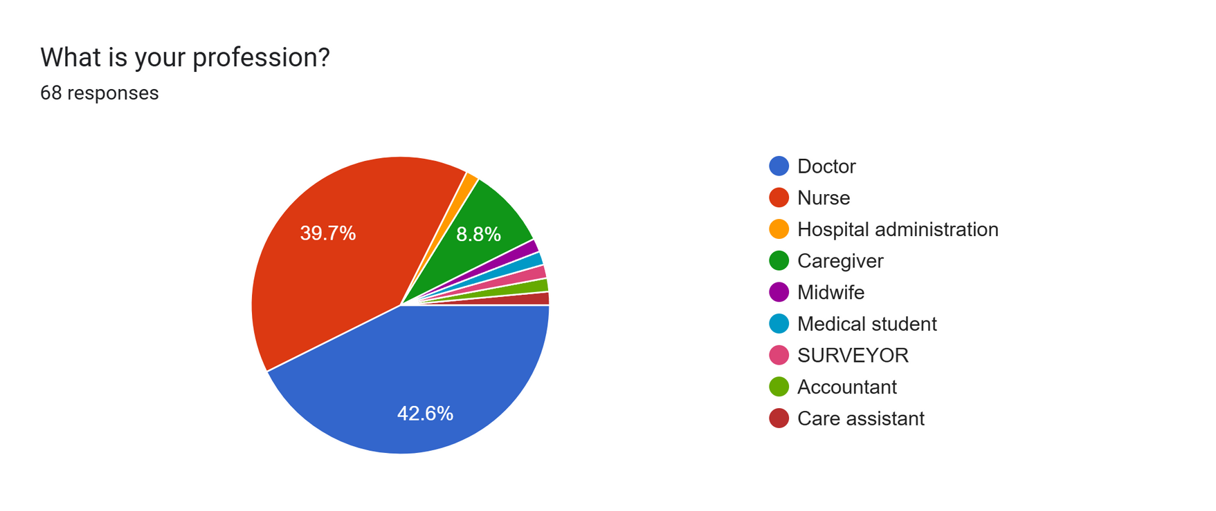
STAKEHOLDER IDENTIFICATION
We conducted a survey on this and received responses from the following professionals

Slide 5
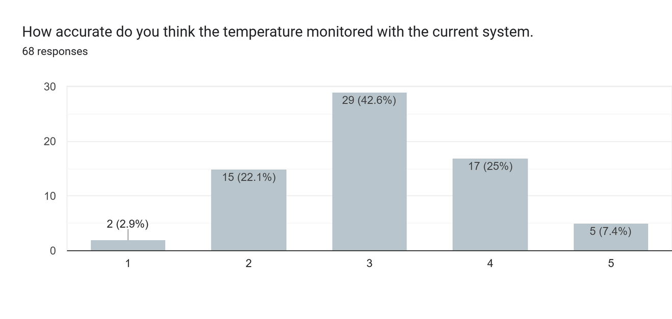
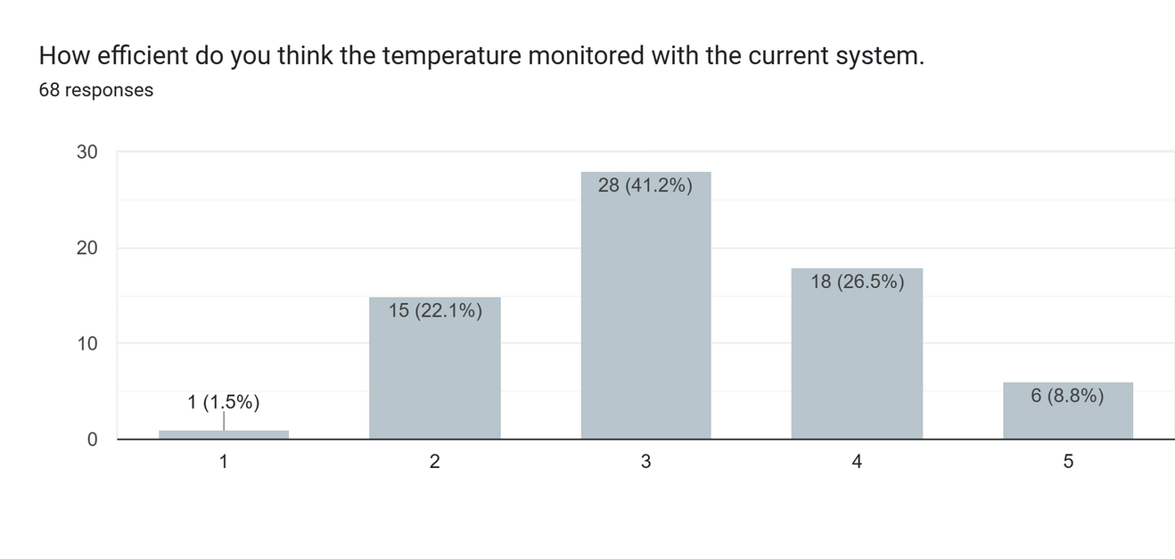
NEED FOR THERMO BAND
In our survey, we asked them about the accuracy and efficiency of the current temperature monitoring system, and the responses are as follows

Slide 6
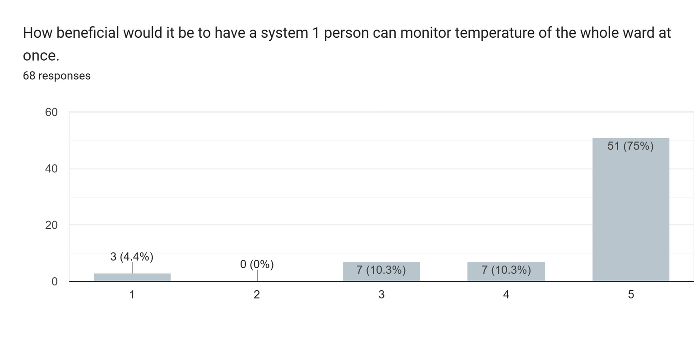
NEED FOR THERMO BAND
And also we asked them How beneficial would it be

Slide 7
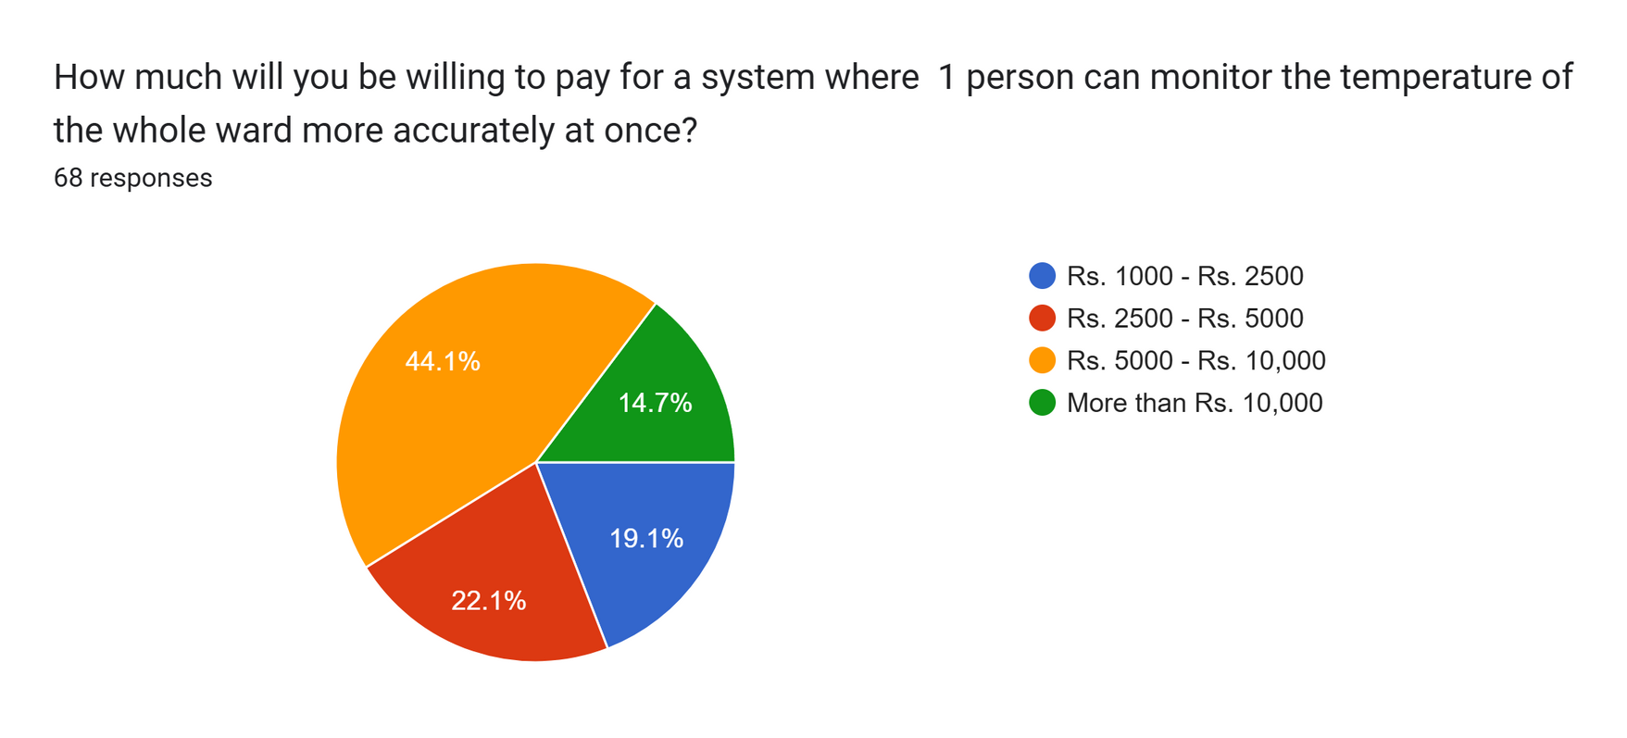
BUDGET

